Slide 1
GTA Housing market
Our Guide To Making Finding A Home A Simpler Experience

Slide 2
Table Of contents
Introduction
Project Overview
Website Overview
Data Storage
Data type
Unique Codes

Slide 3
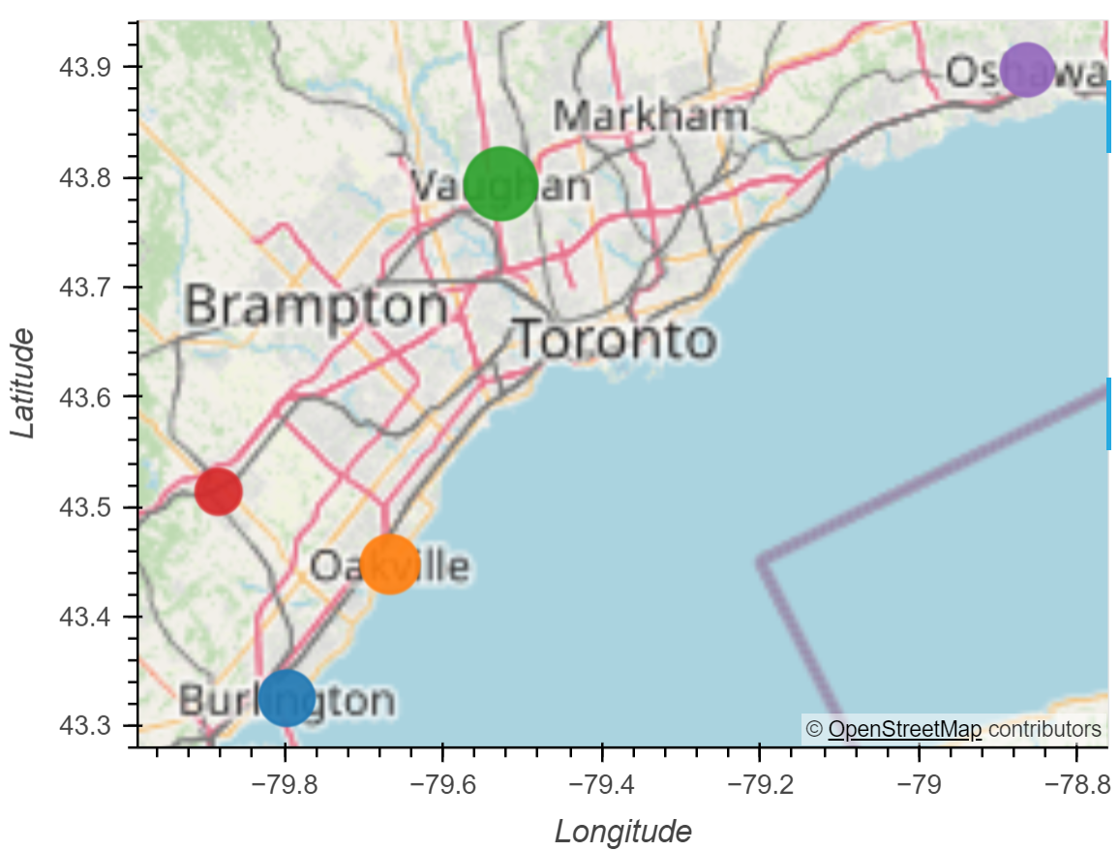
What and why
Oakville, Burlington, Milton, Vaughan and Oshawa
The housing market in these 5 cities were the focus of our research
We wanted to provide an easier way to look into real estate

Slide 4
Our website
We scraped a real estate webpage to gather all the necessary data on the houses in these cities
We plotted all the houses onto a leaflet map of the GTA
We organized the leaflet with filters to improve user compatibility
We added additional information such as the location of leisure spaces near each property
We created various charts to display information a future home buyer might require

Slide 5

Data Storage
Once we collected our data, we put it into MongoDB
We created a few Databases within MongoDB compass to increase the organization of our data
Each group member was able to access the

Slide 6
Data
Example
address: "322 - 95 Dundas Street West "
bathrooms: 2
bedrooms: 2
city: "Oakville"
date_listed: {$date: 1709424000000}
floor_size: 843
garage: 1
latitude: -79.732177
longitude: 43.477181
neighbourhood: "Rural Oakville"
price: 699000
sold_price: 0
status: "Terminated"
type_of_house: "Condo/Apt Unit"
_id: {$oid: '65e4dd1419a2aecb268a2678'}
Amount
Within our MongoDB we have 364 properties/ datasets
212 of these were useable on our HTML as stated when we called it in our console
We have 3306 leisure spots to use for our Leaflet
We collected 5894 records of weather data pertaining to the cities

Slide 7
Databases used
<!-- Bootstrap CSS -->
<link href="https://cdn.jsdelivr.net/npm/bootstrap@5.1.3/dist/css/bootstrap.min.css" rel="stylesheet" integrity="sha384-1BmE4kWBq78iYhFldvKuhfTAU6auU8tT94WrHftjDbrCEXSU1oBoqyl2QvZ6jIW3" crossorigin="anonymous">
<!-- D3 library -->
<script src="https://d3js.org/d3.v7.min.js"></script>
<!-- Leaflet CSS -->
<link rel="stylesheet" href="https://unpkg.com/leaflet@1.9.4/dist/leaflet.css"
integrity="sha256-p4NxAoJBhIIN+hmNHrzRCf9tD/miZyoHS5obTRR9BMY="
crossorigin=""/>
<!-- Leaflet JavaScript code -->
<script src="https://unpkg.com/leaflet@1.9.4/dist/leaflet.js"
integrity="sha256-20nQCchB9co0qIjJZRGuk2/Z9VM+kNiyxNV1lvTlZBo="
crossorigin=""></script>
<!-- Chart.js -->
<script src="https://cdn.jsdelivr.net/npm/chart.js"></script>

Slide 8

Our CODES

Slide 9
Updating charts
// Update chart 1 data
myChart1.data.labels = houseStatusLabels;
myChart1.data.datasets[0].data = houseStatusData;
myChart1.update();
// Update chart 4 data
myChart4.data.labels = Object.keys(neighborhoodAverages);
myChart4.data.datasets[0].data = Object.values(neighborhoodAverages);
myChart4.update();
// Update chart 5 data
myChart5.data.labels = Object.keys(houseTypes);
myChart5.data.datasets[0].data = Object.values(houseTypes);
myChart5.update();
// Update chart 7 data
myChart7.data.labels = Object.keys(neighborhoodPrices);
myChart7.data.datasets[0].data = Object.values(neighborhoodPrices).map(prices => prices.length);
myChart7.update();

Slide 10
Display of the Leaflet Tags
var homeIcon = new LeafIcon({iconUrl: '../static/pink.png'}),
greenIcon = new LeafIcon({iconUrl: '../static/green.png'}),
blueIcon = new LeafIcon({iconUrl: '../static/blue.png'}),
orangeIcon = new LeafIcon({iconUrl:'../static/orange.png'}),
yellowIcon = new LeafIcon({iconUrl: '../static/yellow.png'}),
redIcon = new LeafIcon({iconUrl: '../static/red.png'});
cityIcon = new LeafIcon({iconUrl: '../static/city.png'});
leisureIcon = new LeafIcon({iconUrl: '../static/leisure.png’})
let overlayMaps = {
"<img src='../static/green.png' width='15' /> <span>Up to $500K</span>": layers.one,
"<img src='../static/blue.png' width='15' /> <span>$500K - $750K</span>": layers.two,
"<img src='../static/orange.png' width='15' /> <span>$750K - $1M</span>": layers.three,
"<img src='../static/yellow.png' width='15' /> <span>$1M - $1.25M</span>": layers.four,
"<img src ='../static/red.png' width='15' /> <span>$1.25M+</span>": layers.five,
"<img src='../static/city.png' width='15' /> <span>City </span>": layers.six,
"<img src='../static/leisure.png' width='15' /> <span>Leisure Spots</span>": leisureLayer
};
;

Slide 11
Regex the data
Regex to identify the neighbourhood vs a unit number to separate dashes and categorise address and neighbourhhood:
address_element = article.find('h3', class_='address') address_text = address_element.text.strip() if address_element else None regex_pattern = r'^(\d+\s)?(.+?)\s*-\s*(.*)$' match = re.match(regex_pattern, address_text) if match: address_number = match.group(1) address = match.group(2) neighbourhood = match.group(3) data['Address'] = (address_number + address).strip() if address_number else address.strip() data['Neighbourhood'] = neighbourhood.strip() else: data['Address'] = address_text data['Neighbourhood'] = None

Slide 12
Creators
Peggy Tadi
Robert Skrepnek
Maisie DeGraaf
Jaylene Hughes
Pooja Ranjan Niranjan

